Slide 1
MATHEMATICS FOR ENGINEERS MA5101-PARTIAL DIFFERENTIAL EQUATIONS
PANCHATCHARAM MARIAPPAN
PANCH.M@IITTP.AC.IN
November 2018

Slide 2
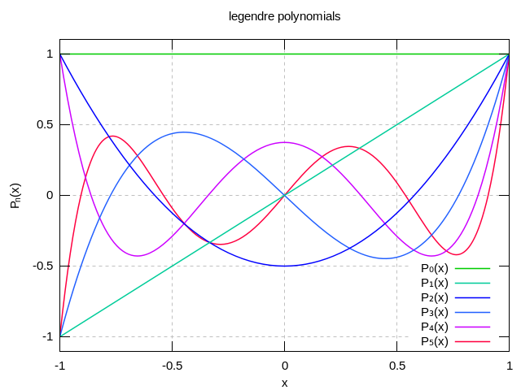
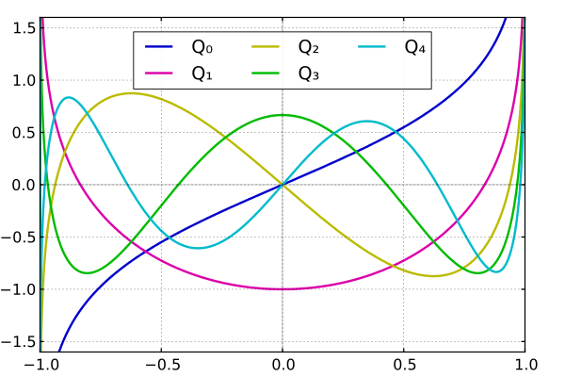
Legendre Polynomials
Second Kind
First Kind

Slide 3
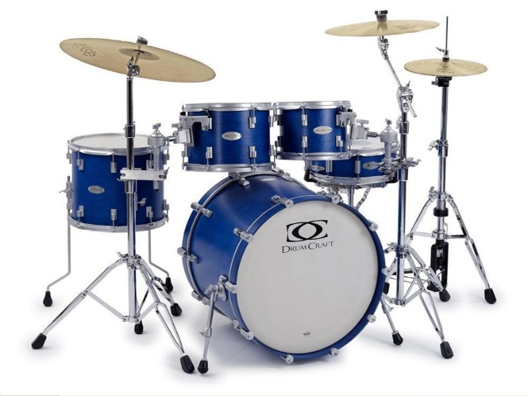
Bessel Functions
Electromagnetic/Cylindrical Waveguide
Heat Conduction
Schrödinger Equation
Acoustics Problem
Acoustic Radiation
Signal Processing – Bessel Filter, Kaiser Window, FM

Slide 4
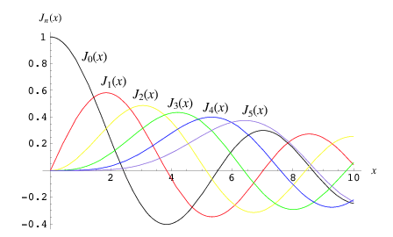
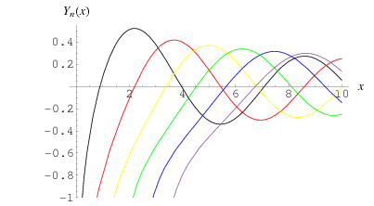
Bessel Functions
Second Kind
First Kind

Slide 5
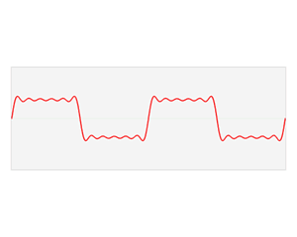
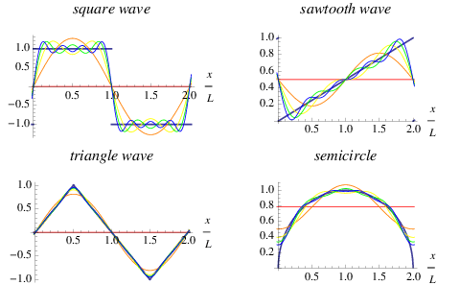
Fourier Series

Slide 6
Partial Differential Equation
An equation that contains one or more partial derivatives of an unknown function that depends on at least two variables
Unknown function, u depends on two or more variables
Time: t and space variables: x, y, z
Order of the highest derivative is called the order of the PDE.
Linear/Nonlinear: If it is of the first degree in u, and its partial derivatives.
Homogeneous/Nonhomogeneous: A linear PDE, if each of its term contains either u or one of its partial derivatives.

Slide 7
Important Second-Order PDEs

Slide 8
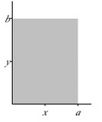
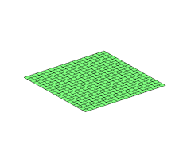
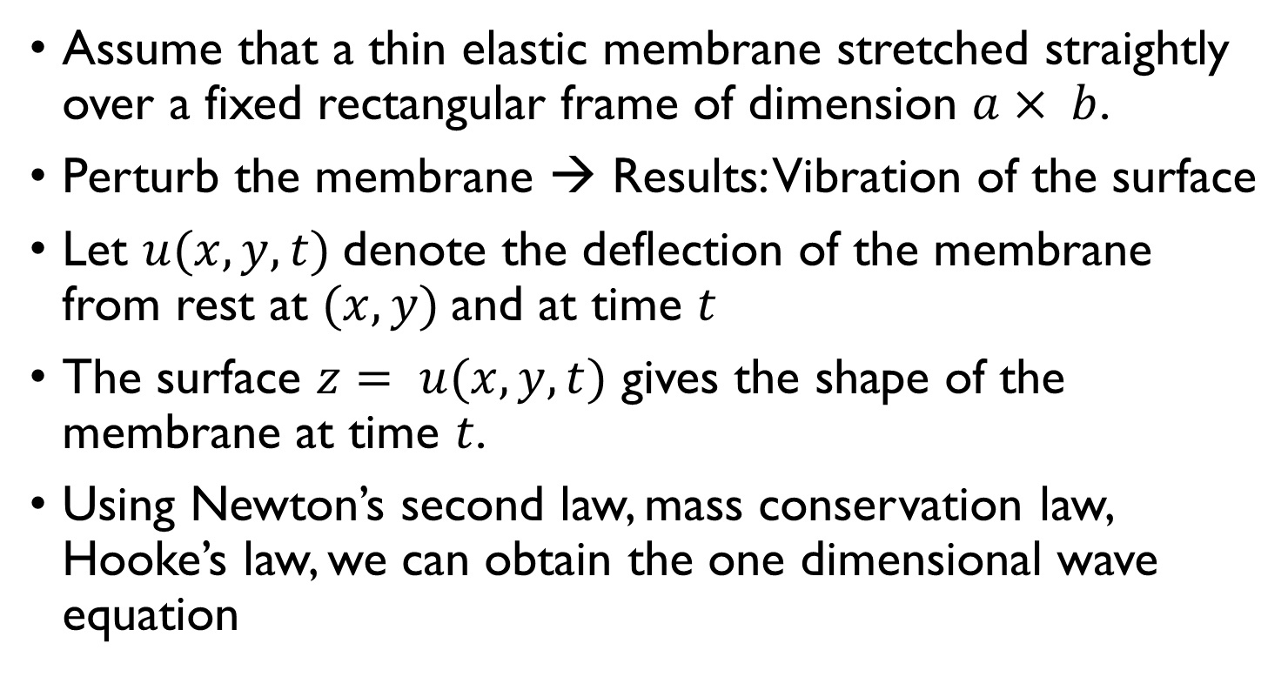
Wave Equation
Assume that a thin elastic membrane stretched straightly over a fixed rectangular frame of dimension $a× b$.
Perturb the membrane → Results: Vibration of the surface
Let $u(x, y, t)$denote the deflection of the membrane from rest at $(x, y)$and at time $t$
The surface $z= u(x, y, t)$ gives the shape of the membrane at time $t$.
Using Newton’s second law, mass conservation law, Hooke’s law, we can obtain the one dimensional wave equation

Slide 9
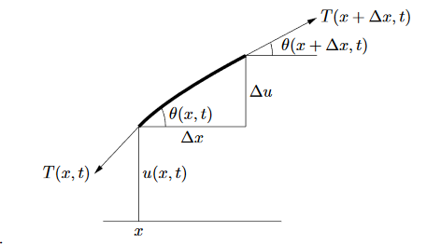
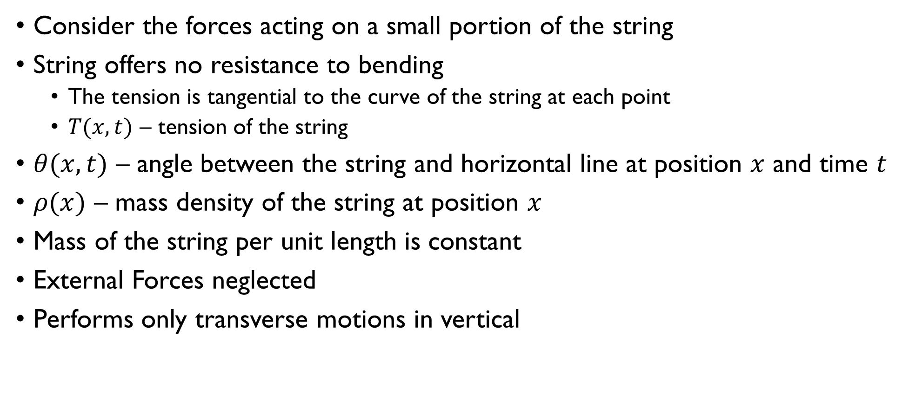
Wave Equation
Consider the forces acting on a small portion of the string
String offers no resistance to bending
The tension is tangential to the curve of the string at each point
$T(x,t)$ – tension of the string
$θ(x,t)$ – angle between the string and horizontal line at position $x$ and time $t$
$ρ(x)$ – mass density of the string at position $x$
Mass of the string per unit length is constant
External Forces neglected
Performs only transverse motions in vertical

Slide 10
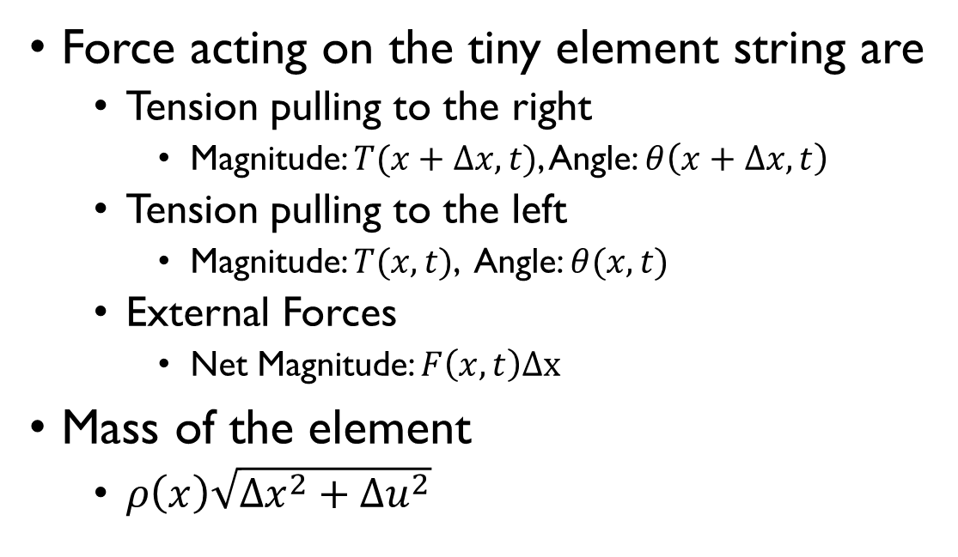
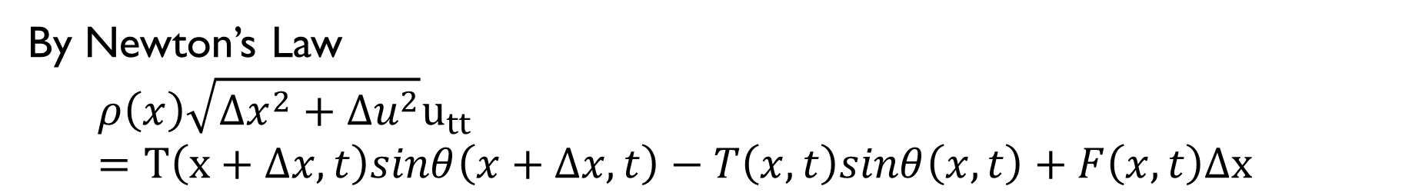
Wave Equation
Force acting on the tiny element string are
Tension pulling to the right
Magnitude: $T(x+Δx,t)$, Angle: $θ\left(x+Δx,t\right)$
Tension pulling to the left
Magnitude: $T(x,t)$, Angle: $θ(x,t)$
External Forces
Net Magnitude: $F\left(x,t\right)Δx$
Mass of the element
$ρ\left(x\right)\sqrt{Δx^{2}+Δu^{2}}$
By Newton’s Law
$$ρ\left(x\right)\sqrt{Δx^{2}+Δu^{2}}u_{tt}=T\left(x+Δx,t\right)sinθ\left(x+Δx,t\right)−T\left(x,t\right)sinθ\left(x,t\right)+F\left(x,t\right)Δx$$

Slide 11
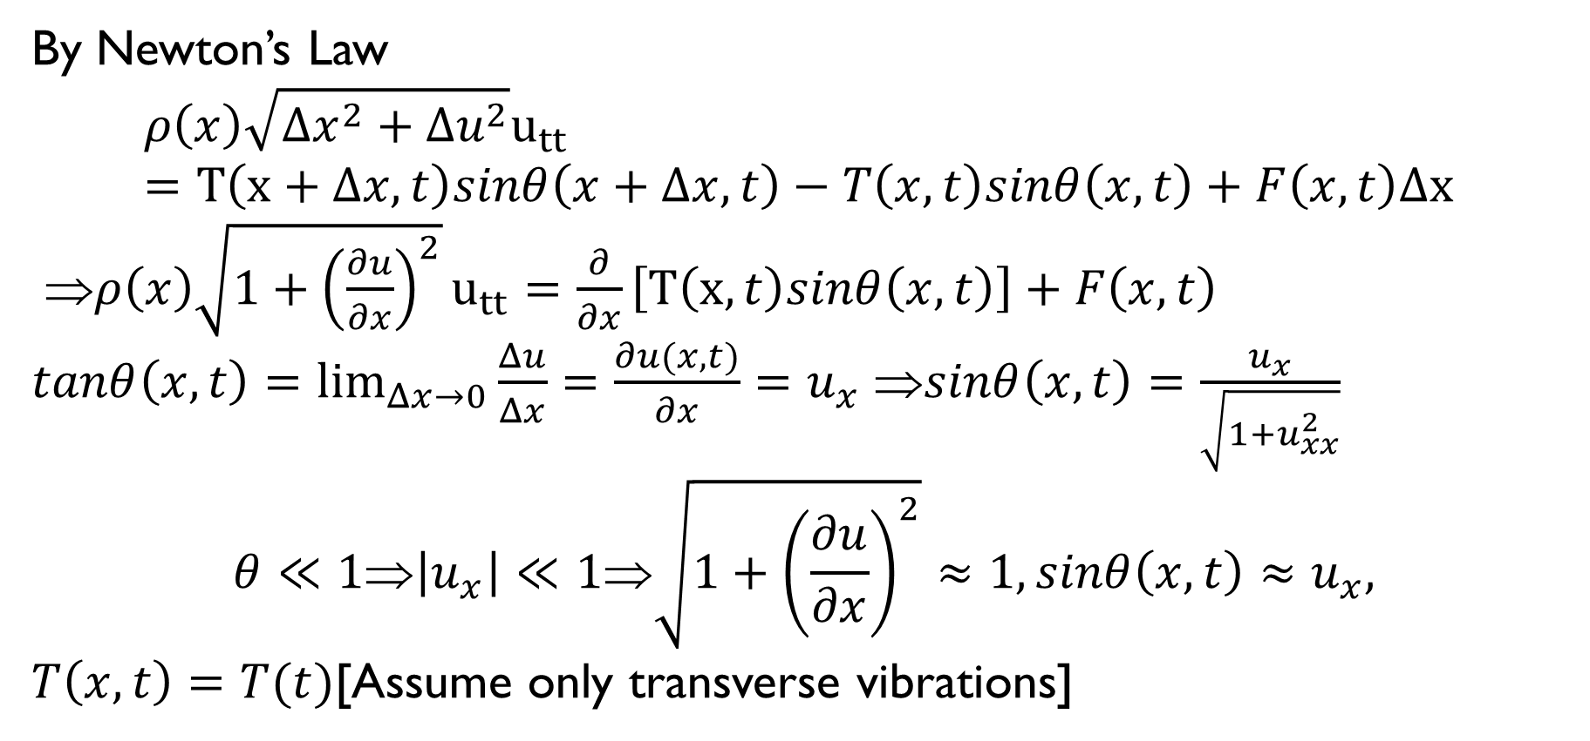
Wave Equation
By Newton’s Law
$$ρ\left(x\right)\sqrt{Δx^{2}+Δu^{2}}u_{tt}=T\left(x+Δx,t\right)sinθ\left(x+Δx,t\right)−T\left(x,t\right)sinθ\left(x,t\right)+F\left(x,t\right)Δx$$
⇒$ρ\left(x\right)\sqrt{1+{\left(\frac{∂u}{∂x}\right)}^{2}}u_{tt}=\frac{∂}{∂x}\left[T\left(x,t\right)sinθ\left(x,t\right)\right]+F\left(x,t\right)$
$tanθ\left(x,t\right)=\lim_{Δx→0}{\frac{Δu}{Δx}=\frac{∂u(x,t)}{∂x}}=u_{x}$ ⇒$sinθ\left(x,t\right)=\frac{u_{x}}{\sqrt{1+u_{xx}^{2}}}$
$$θ≪1⇒\left|u_{x}\right|≪1⇒\sqrt{1+{\left(\frac{∂u}{∂x}\right)}^{2}}≈1,sinθ\left(x,t\right)≈u_{x},$$
$T\left(x,t\right)=T(t)$[Assume only transverse vibrations]

Slide 12
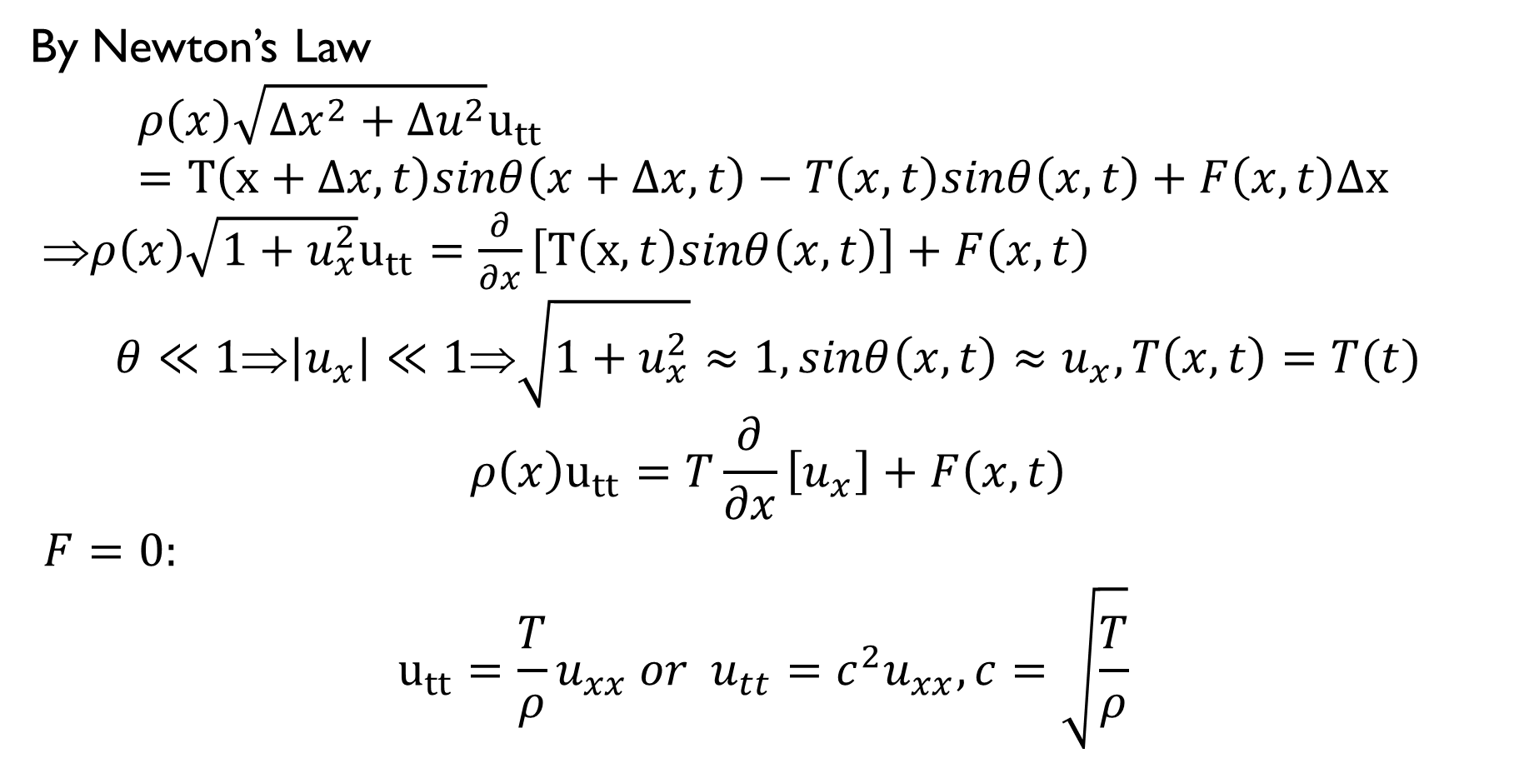
Wave Equation
By Newton’s Law
$$ρ\left(x\right)\sqrt{Δx^{2}+Δu^{2}}u_{tt}=T\left(x+Δx,t\right)sinθ\left(x+Δx,t\right)−T\left(x,t\right)sinθ\left(x,t\right)+F\left(x,t\right)Δx$$
⇒$ρ\left(x\right)\sqrt{1+u_{x}^{2}}u_{tt}=\frac{∂}{∂x}\left[T\left(x,t\right)sinθ\left(x,t\right)\right]+F\left(x,t\right)$
$$θ≪1⇒\left|u_{x}\right|≪1⇒\sqrt{1+u_{x}^{2}}≈1,sinθ\left(x,t\right)≈u_{x},T\left(x,t\right)=T(t)$$
$$ρ\left(x\right)u_{tt}=T\frac{∂}{∂x}\left[u_{x}\right]+F\left(x,t\right)$$
$F=0:$
$$u_{tt}=\frac{T}{ρ}u_{xx} or u_{tt}=c^{2}u_{xx}, c=\sqrt{\frac{T}{ρ}}$$

Slide 13
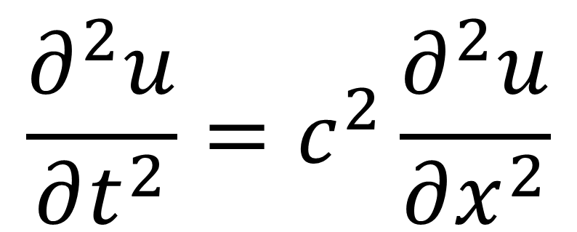
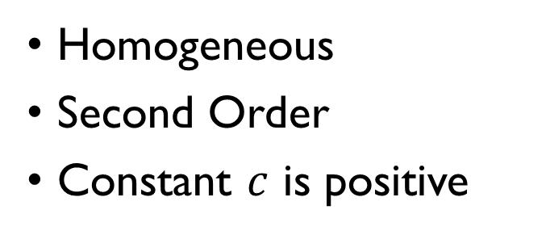
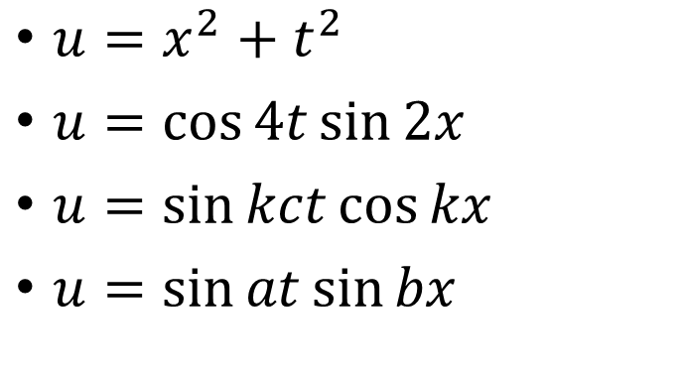
Wave Equation (One – D)
$$\frac{∂^{2}u}{∂t^{2}}=c^{2}\frac{∂^{2}u}{∂x^{2}}$$
$u=x^{2}+t^{2}$
$u=\cos{4t}\sin{2x}$
$u=\sin{kct}\cos{kx}$
$u=\sin{at}\sin{bx}$
Homogeneous
Second Order
Constant $c$ is positive

Slide 14
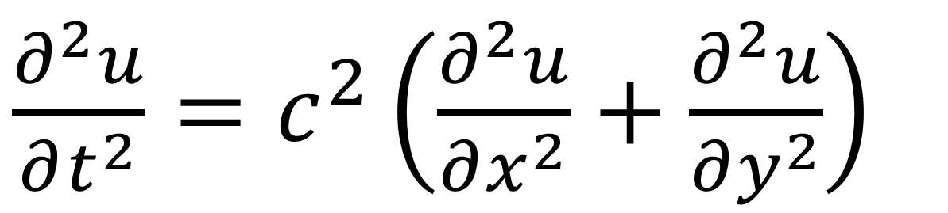
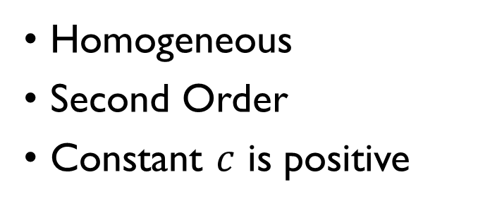
Wave Equation (Two – D)
$\frac{∂^{2}u}{∂t^{2}}=c^{2}\left(\frac{∂^{2}u}{∂x^{2}}+\frac{∂^{2}u}{∂y^{2}}\right)$
Homogeneous
Second Order
Constant $c$ is positive

Slide 15
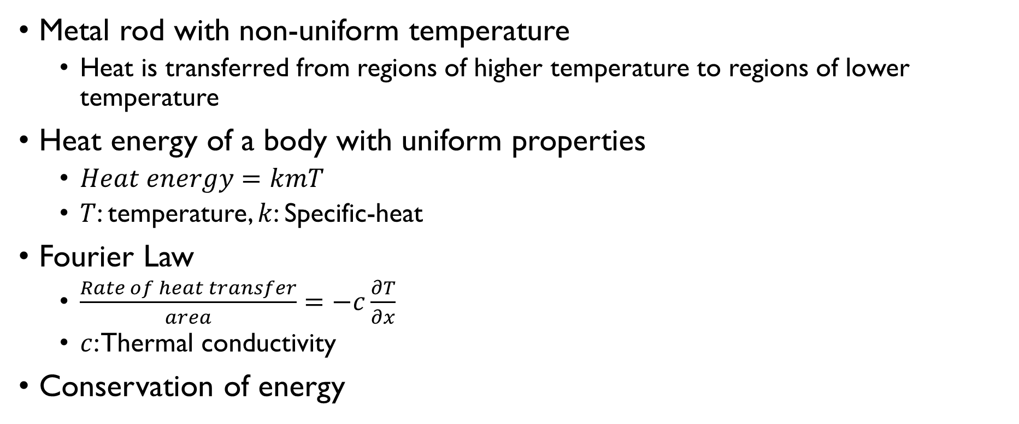
Heat Equation
Metal rod with non-uniform temperature
Heat is transferred from regions of higher temperature to regions of lower temperature
Heat energy of a body with uniform properties
$Heat energy=kmT$
$T$: temperature, $k$: Specific-heat
Fourier Law
$\frac{Rate of heat transfer}{area}=−c\frac{∂T}{∂x}$
$c$: Thermal conductivity
Conservation of energy

Slide 16
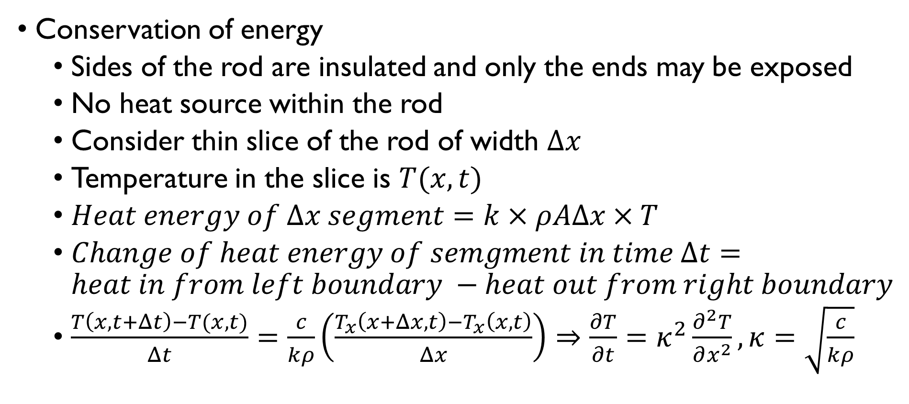
Heat Equation
Conservation of energy
Sides of the rod are insulated and only the ends may be exposed
No heat source within the rod
Consider thin slice of the rod of width $Δx$
Temperature in the slice is $T(x,t)$
$Heat energy of Δx segment=k×ρAΔx×T$
$Change of heat energy of semgment in time Δt=heat in from left boundary −heat out from right boundary$
$\frac{T\left(x,t+Δt\right)−T(x,t)}{Δt}=\frac{c}{kρ}\left(\frac{T_{x}\left(x+Δx,t\right)−T_{x}\left(x,t\right)}{Δx}\right)⇒\frac{∂T}{∂t}=κ^{2}\frac{∂^{2}T}{∂x^{2}},κ=\sqrt{\frac{c}{kρ}}$

Slide 17
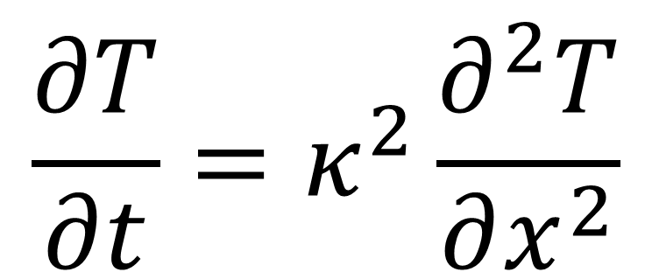
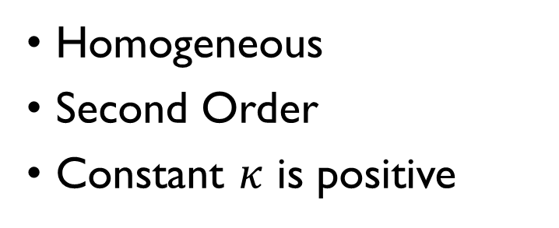
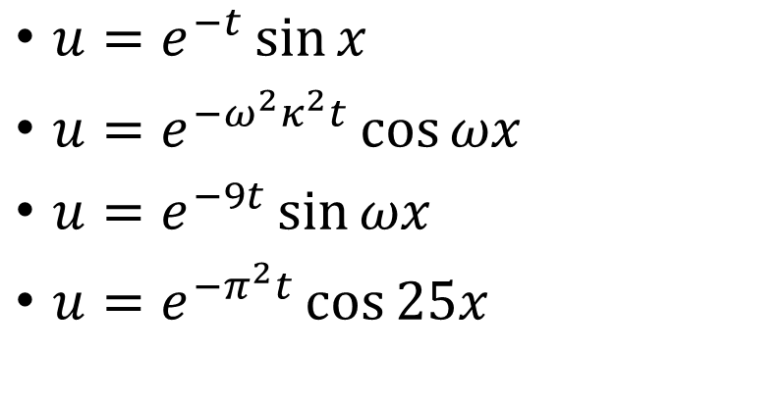
Heat Equation
$$\frac{∂T}{∂t}=κ^{2}\frac{∂^{2}T}{∂x^{2}}$$
Homogeneous
Second Order
Constant $κ$ is positive
$u=e^{−t}\sin{x}$
$u=e^{−ω^{2}κ^{2}t}\cos{ωx}$
$u=e^{−9t}\sin{ωx}$
$u=e^{−π^{2}t}\cos{25x}$

Slide 18
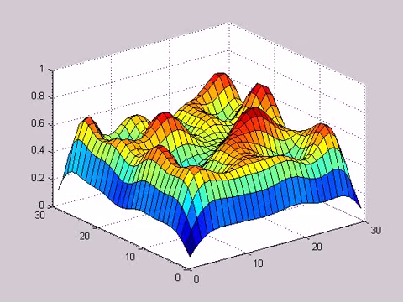
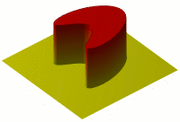
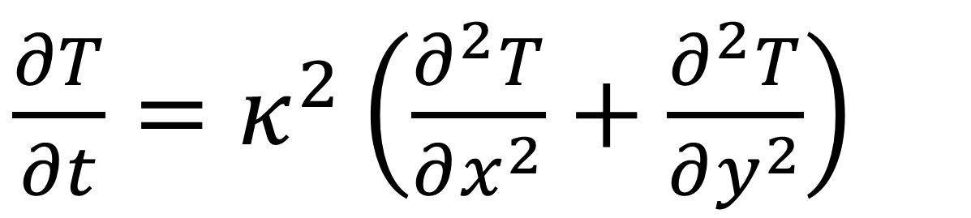
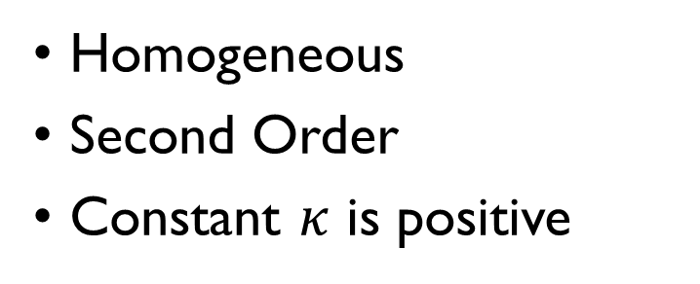
Heat Equation (Two – D)
$\frac{∂T}{∂t}=κ^{2}\left(\frac{∂^{2}T}{∂x^{2}}+\frac{∂^{2}T}{∂y^{2}}\right)$
Homogeneous
Second Order
Constant $κ$ is positive

Slide 19
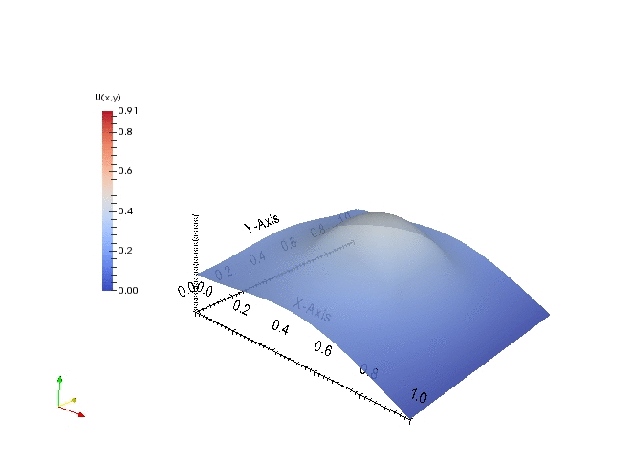
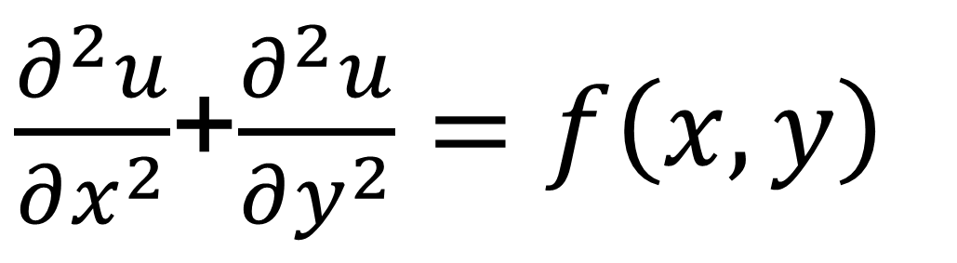
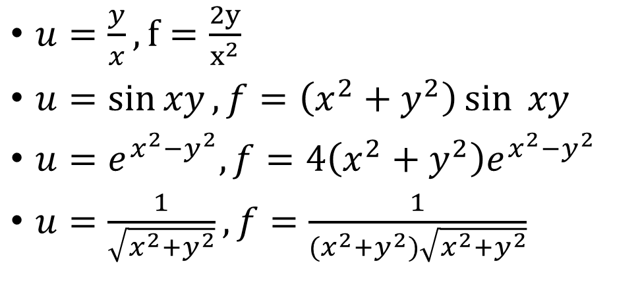
Poisson Equation (Two – D)
$\frac{∂^{2}u}{∂x^{2}}$+$\frac{∂^{2}u}{∂y^{2}}=f\left(x,y\right)$
$u=\frac{y}{x}, f=\frac{2y}{x^{2}}$
$u=\sin{xy}, f=\left(x^{2}+y^{2}\right)\sin{ xy}$
$u=e^{x^{2}−y^{2}}, f=4\left(x^{2}+y^{2}\right)e^{x^{2}−y^{2}}$
$u=\frac{1}{\sqrt{x^{2}+y^{2}}},f=\frac{1}{(x^{2}+y^{2})\sqrt{x^{2}+y^{2}}}$
Homogeneous
Second Order

Slide 20
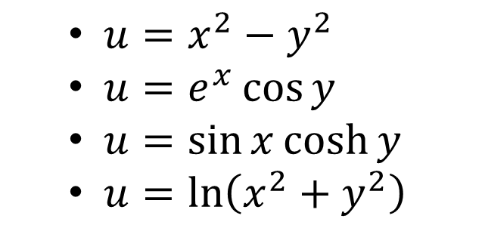
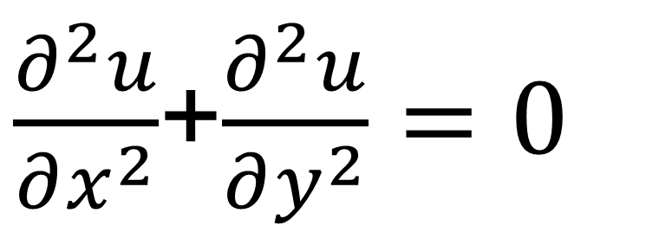
Laplace Equation (Two – D)
$\frac{∂^{2}u}{∂x^{2}}$+$\frac{∂^{2}u}{∂y^{2}}=0$
Homogeneous
Second Order
$u=x^{2}−y^{2}$
$u=e^{x}\cos{y}$
$u=\sin{x}\cosh{y}$
$u=\ln\left(x^{2}+y^{2}\right)$

Slide 21
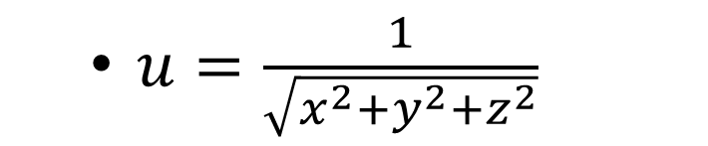
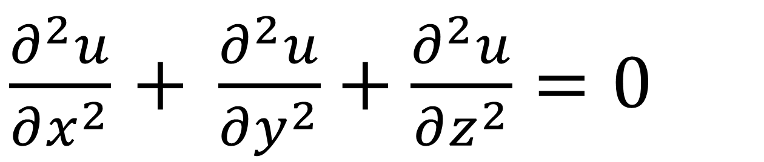
Laplace Equation (Three – D)
$\frac{∂^{2}u}{∂x^{2}}$ $+ \frac{∂^{2}u}{∂y^{2}}+\frac{∂^{2}u}{∂z^{2}}=0$
$u=\frac{1}{\sqrt{x^{2}+y^{2}+z^{2}}}$
Homogeneous
Second Order

Slide 22
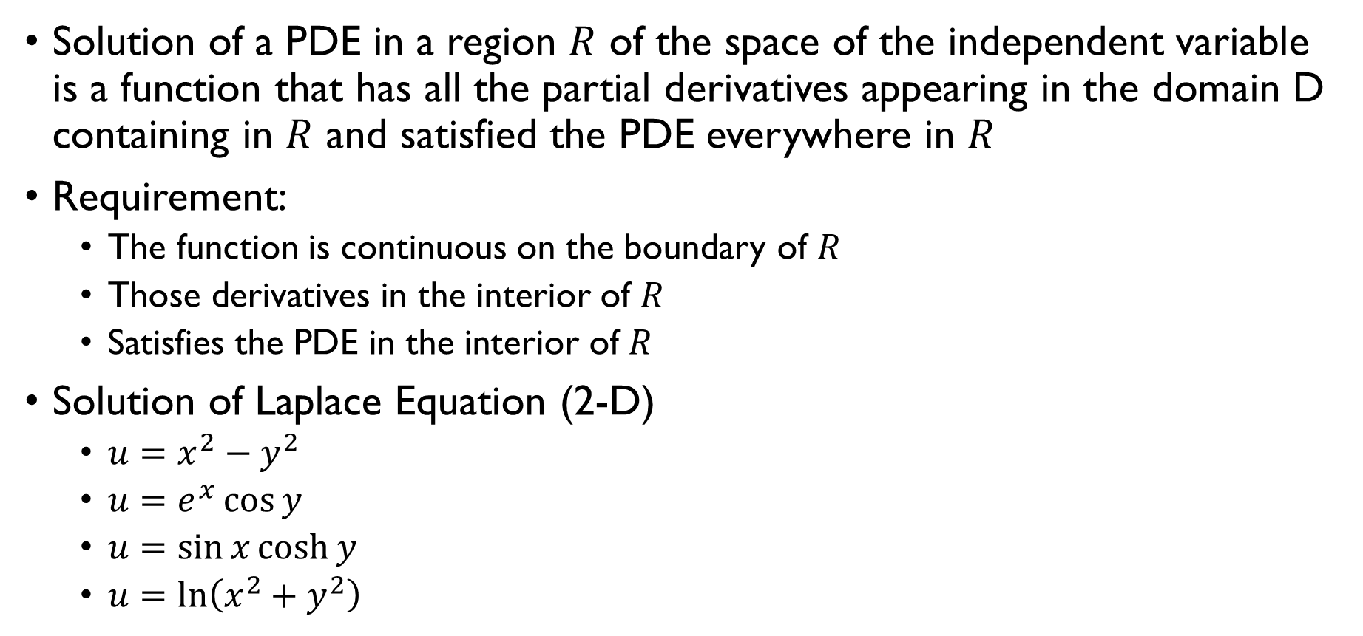
Solution of a PDE
Solution of a PDE in a region $R$ of the space of the independent variable is a function that has all the partial derivatives appearing in the domain D containing in $R$ and satisfied the PDE everywhere in $R$
Requirement:
The function is continuous on the boundary of $R$
Those derivatives in the interior of $R$
Satisfies the PDE in the interior of $R$
Solution of Laplace Equation (2-D)
$u=x^{2}−y^{2}$
$u=e^{x}\cos{y}$
$u=\sin{x}\cosh{y}$
$u=\ln\left(x^{2}+y^{2}\right)$

Slide 23
Unique Solution of a PDE
Additional conditions required to obtain unique solutions
Boundary Conditions
Initial Conditions

Slide 24
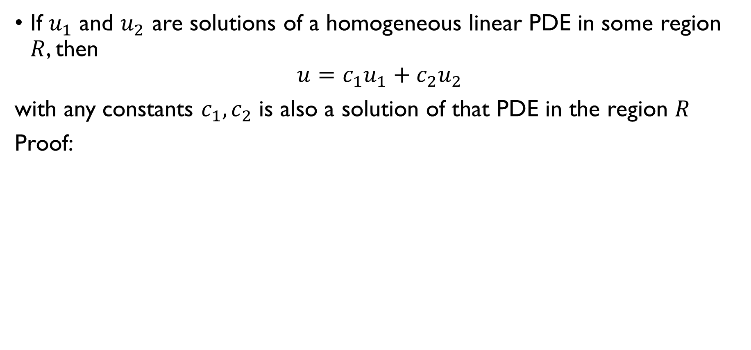
Fundamental Theorem on Superposition
If $u_{1}$ and $u_{2}$ are solutions of a homogeneous linear PDE in some region $R$, then
$$u=c_{1}u_{1}+c_{2}u_{2}$$
with any constants $c_{1},c_{2}$ is also a solution of that PDE in the region $R$
Proof:

